Slide 1

Exam DP-201: Designing a Microsoft Azure Data Solution Crash Course
Tim Warner

Slide 2


Tim Warner
Based in Nashville, TN, US
Central time zone
MCT, MVP
Twitter: @TechTrainerTim
Badge: timw.info/dpcert

Slide 3
Day 1 of 2 Agenda
Introduction
Design Azure Storage Solutions
Design for Data Security and Compliance

Slide 4
Day 2 of 2 Agenda
Content catch-up from Day 1
Design Data Processing Solutions
Exam DP-201 strategy

Slide 5
Course Materials
timw.info/dp201

Slide 6
A Different Kind of Training
We'll learn by doing – at least 80 percent demo
Visual, case study approach
10-minute break at midpoint
I’m here to answer your questions – take advantage of this!
Use the Q&A panel

Slide 7

Session Recordings

Slide 8
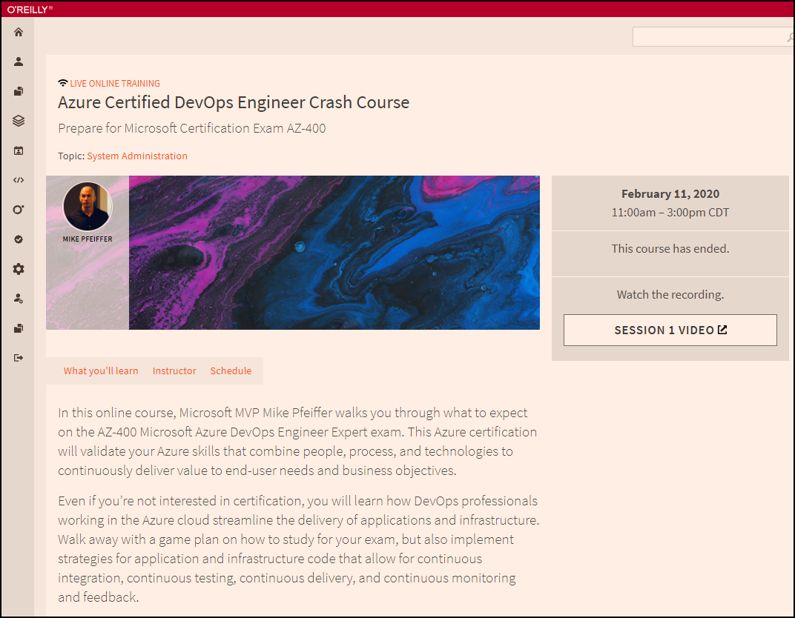
Session Recordings

Slide 9

Session Recordings

Slide 10

DP-201 Changes in 2021
Until June 30, 2021
DP-200
DP-201

Slide 11

DP-201 Changes in 2021
After June 30, 2021
DP-203
DP-203
DP-203
Data Engineering on Microsoft Azure
Data Engineering on Microsoft Azure

Slide 12
What is an Azure Data Engineer?
Design and implement the management, monitoring, security, and privacy of data using the full stack of data services
“Builds and tunes data pipelines”
“Implements, monitors, and optimizes data platforms”
“Has solid knowledge of SQL, Python, or Scala”
The Azure Data Scientist consumes the data the Engineer provides

Slide 13
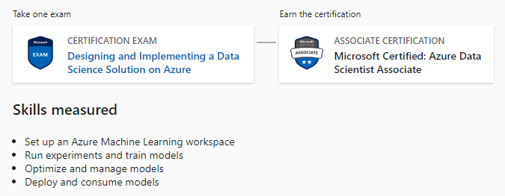
Azure Data Scientist Associate
DP-100

Slide 14
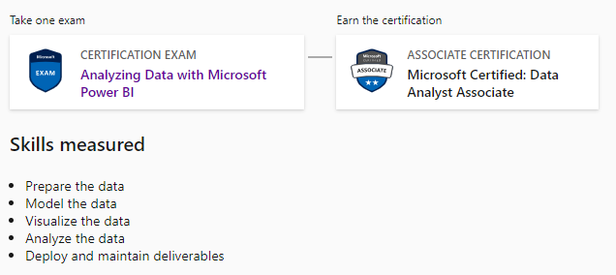
Azure Data Analyst Associate
DA-100

Slide 15
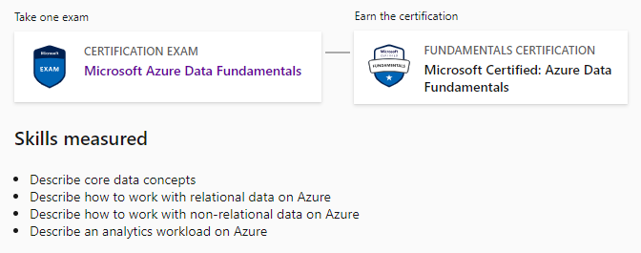
Azure Data Fundamentals
DP-900

Slide 16

Case Study

Slide 17

Active Screen

Slide 18
Tim's Certification Study Pyramid
Interdependence
Content knowledge
Practical application
Test-taking skills

Slide 19
Thank you!
Course materials: timw.info/dp201
Twitter: @TechTrainerTim
Work: timw.info/ps
Web: TechTrainerTim.com

Slide 20
Non-Relational Data

Slide 21
Non-Relational Data Characteristics
## Customer 1 ID: 1
Name: Mark Hanson
Telephone: [ Home: 1-999-9999999, Business: 1-888-8888888, Cell: 1-777- 7777777 ]
Address: [ Home: 121 Main Street, Some City, NY, 10110,
Business: 87 Big Building, Some City, NY, 10111 ]
## Customer 2 ID: 2
Title: Mr
Name: Jeff Hay
Telephone: [ Home: 0044-1999-333333, Mobile: 0044-17545-444444 ]
Address: [ UK: 86 High Street, Some Town, A County, GL8888, UK,
US: 777 7th Street, Another City, CA, 90111 ]
Non-relational collections can have:
Multiple entities in the same collection or container with different fields
Have a different, non-tabular schema
Are often defined by labeling each field with the name it represents

Slide 22
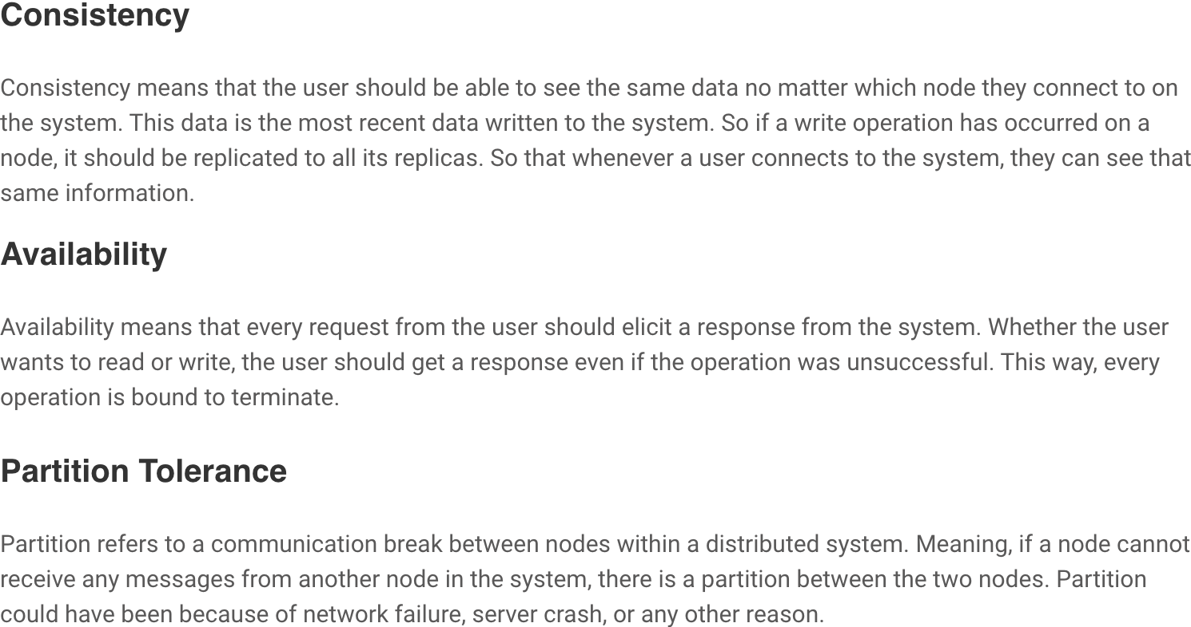
CAP Theorem

Slide 23
Azure Blob Storage
Block blobs
Page blobs
Append blobs
Has a maximum size of 4.7TB
Best for storing large, discrete, binary objects that changes infrequently
Each individual block can store up to 100MB of data
A block blob can contain up to 50000 blocks
Can hold up to 8TB of data
Is organized as a collection of fixed sized-512 byte pages
Used to implement virtual disk storage for virtual machines
The maximum size is just over 195GB
Is a block blob that is used to optimize append operations
Each individual block can store up to 4MB of data

Slide 24
Azure Table Storage
Key (Customer ID)
Value (Customer Data)
C1
AAAAA
BBB
101 Block Street
YY
999
888
C2
MM
NN
21 A Street
5 B Avenue
C3
DDD
EEE
FFF
111
222
66 C Road

Slide 25
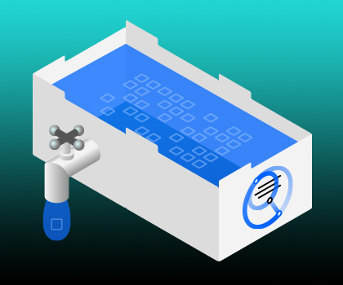
Data Lake

Slide 26

ADLS Gen 2
A repository of data for your Modern Data Warehouse
Organises data into directories for improved file access
Supports POSIX and RBAC permissions
It is compatible with Hadoop Distributed File System
Store
Azure Data Lake Storage
High performance data lake available in all 54 Azure regions

Slide 27
Storage Account Replication
1
3
3
2
LRS
ZRS

Slide 28
Storage Account Replication
3
3
GRS/RA-GRS

Slide 29
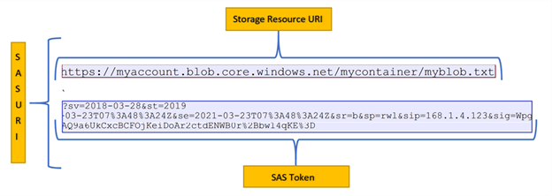
SAS Tokens

Slide 30
Azure Cosmos DB
Scalability
Performance
Availability
Programming model

Slide 31
Cosmos DB APIs
SQL API
Table API
MongoDB API
Cassandra API
Gremlin API
Supports SQL-like query language
Compatible with Azure Table Storage
Compatible with MongoDB
Compatible with Cassandra
A graph database

Slide 32
Cosmos DB SQL API
COUNT( <fields_to_count> )
SUM( <numeric_fields> )
AVG( <numeric_fields> )
MAX( <numeric_fields> )
MIN( <numeric_fields> )
Aggregation Function Basics
SQL API examples
SELECT COUNT(*) FROM Products p
SELECT SUM(p.quantity) FROM Products p
WHERE p.expired = 0
SELECT AVG(p.price) AS ‘Average Price’
FROM Products p
SELECT p1.ID, p.Name, p1.Description, p1.Price FROM Products p1
WHERE p1.Price = (SELECT MIN(p2.Price) FROM Product p2)

Slide 33
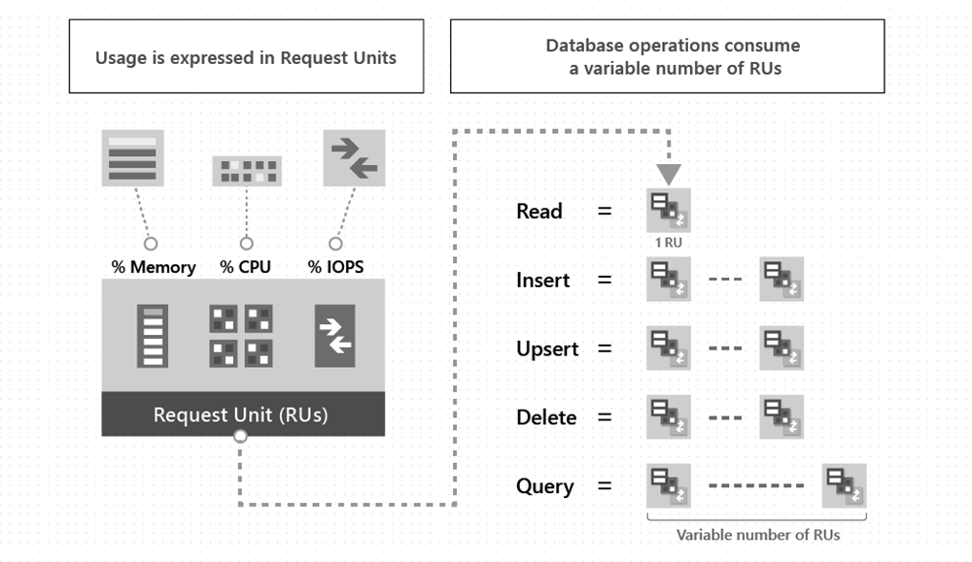
Request Units (RUs)

Slide 34
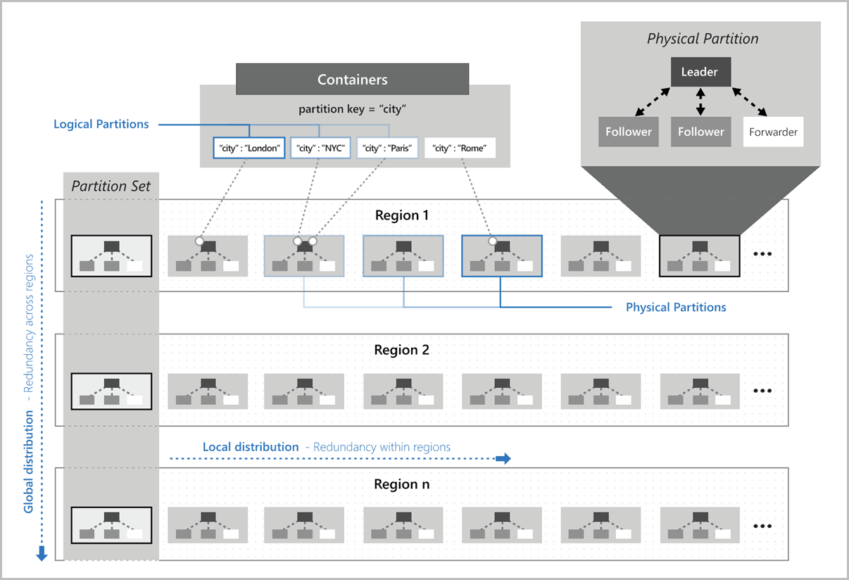
Cosmos DB Partitioning
Partition key:
* Value that doesn't change
* High cardinality
* SPs support ACID transactions

Slide 35
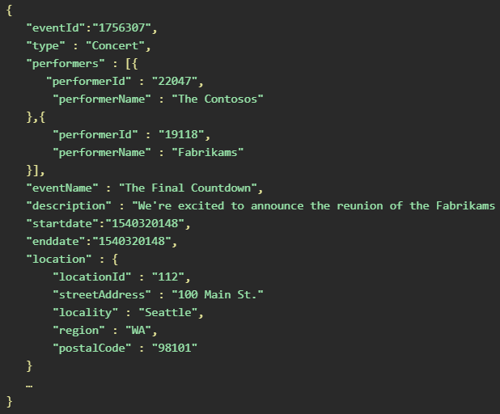
Cosmos DB Partitioning
High cardinality
(/eventId)
/location/locationId

Slide 36
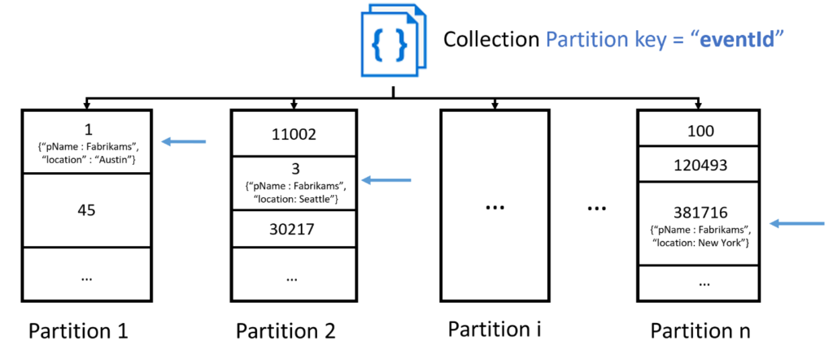
Cosmos DB Partitioning
Avoid "hot" partitions

Slide 37
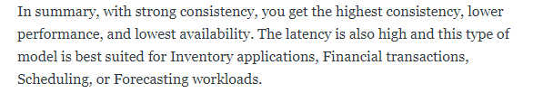
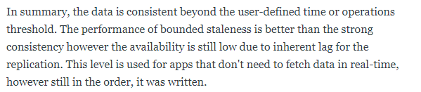

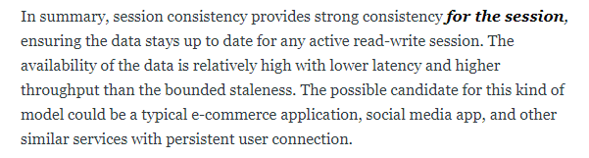
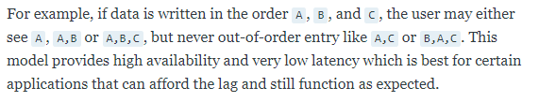
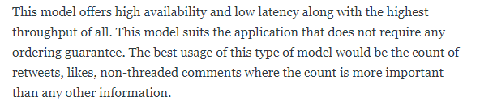
Consistency Levels
Strong
Bounded Staleness
Session
Consistent Prefix
Eventual
https://timw.info/fhq

Slide 38
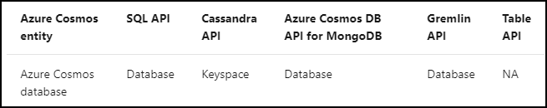
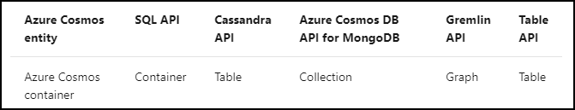
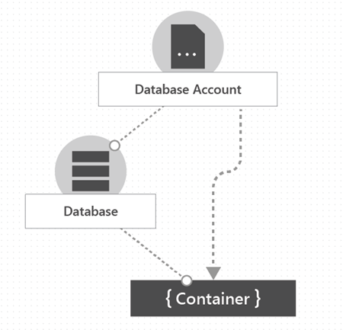
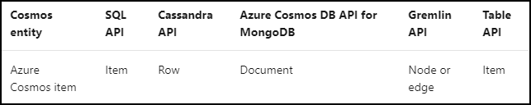
Cosmos DB Resource Model
Database
Container
Item
https://timw.info/ft6

Slide 39
Storage Account Replication
1
3
1
3
2
2
GZRS – RA/GZRS

Slide 40

Always Encrypted

Slide 41
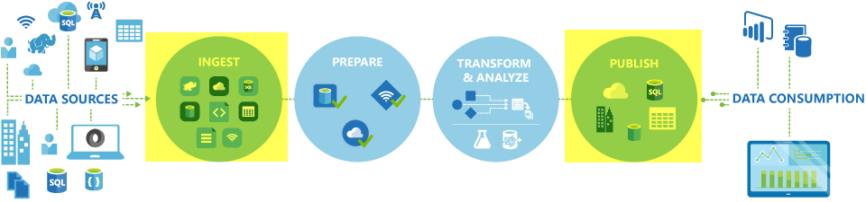
Azure Data Factory

Slide 42

Azure Monitor

Slide 43

Data Pipelines

Slide 44
Azure Diagnostics

Slide 45

Log Analytics

Slide 46
Relational Data

Slide 47

Relational Database Use Cases
Identify relational database use cases
IoT:
Although typically considered for non-relational, the data from IoT devices could be structured and consistent
Online transaction processing:
For example order systems that perform many small transactional updates
Data warehousing:
Large amounts of data can be imported from multiple sources and structured to enable high-performance queries

Slide 48
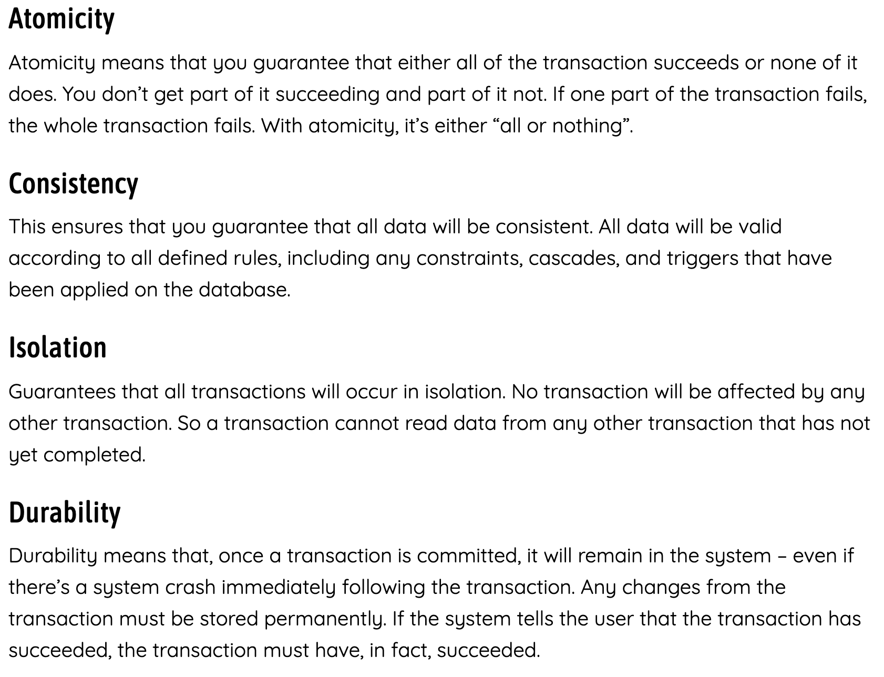
ACID Principle

Slide 49
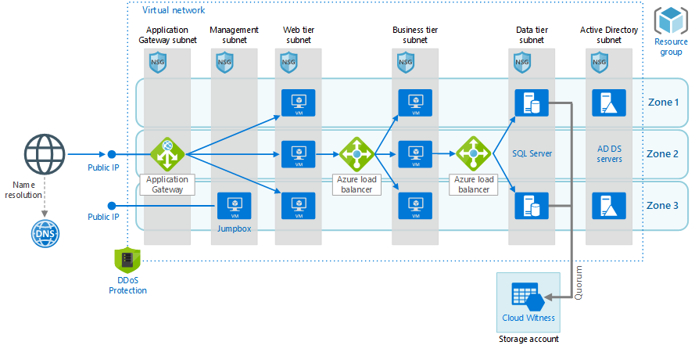
SQL Server in an Azure VM

Slide 50
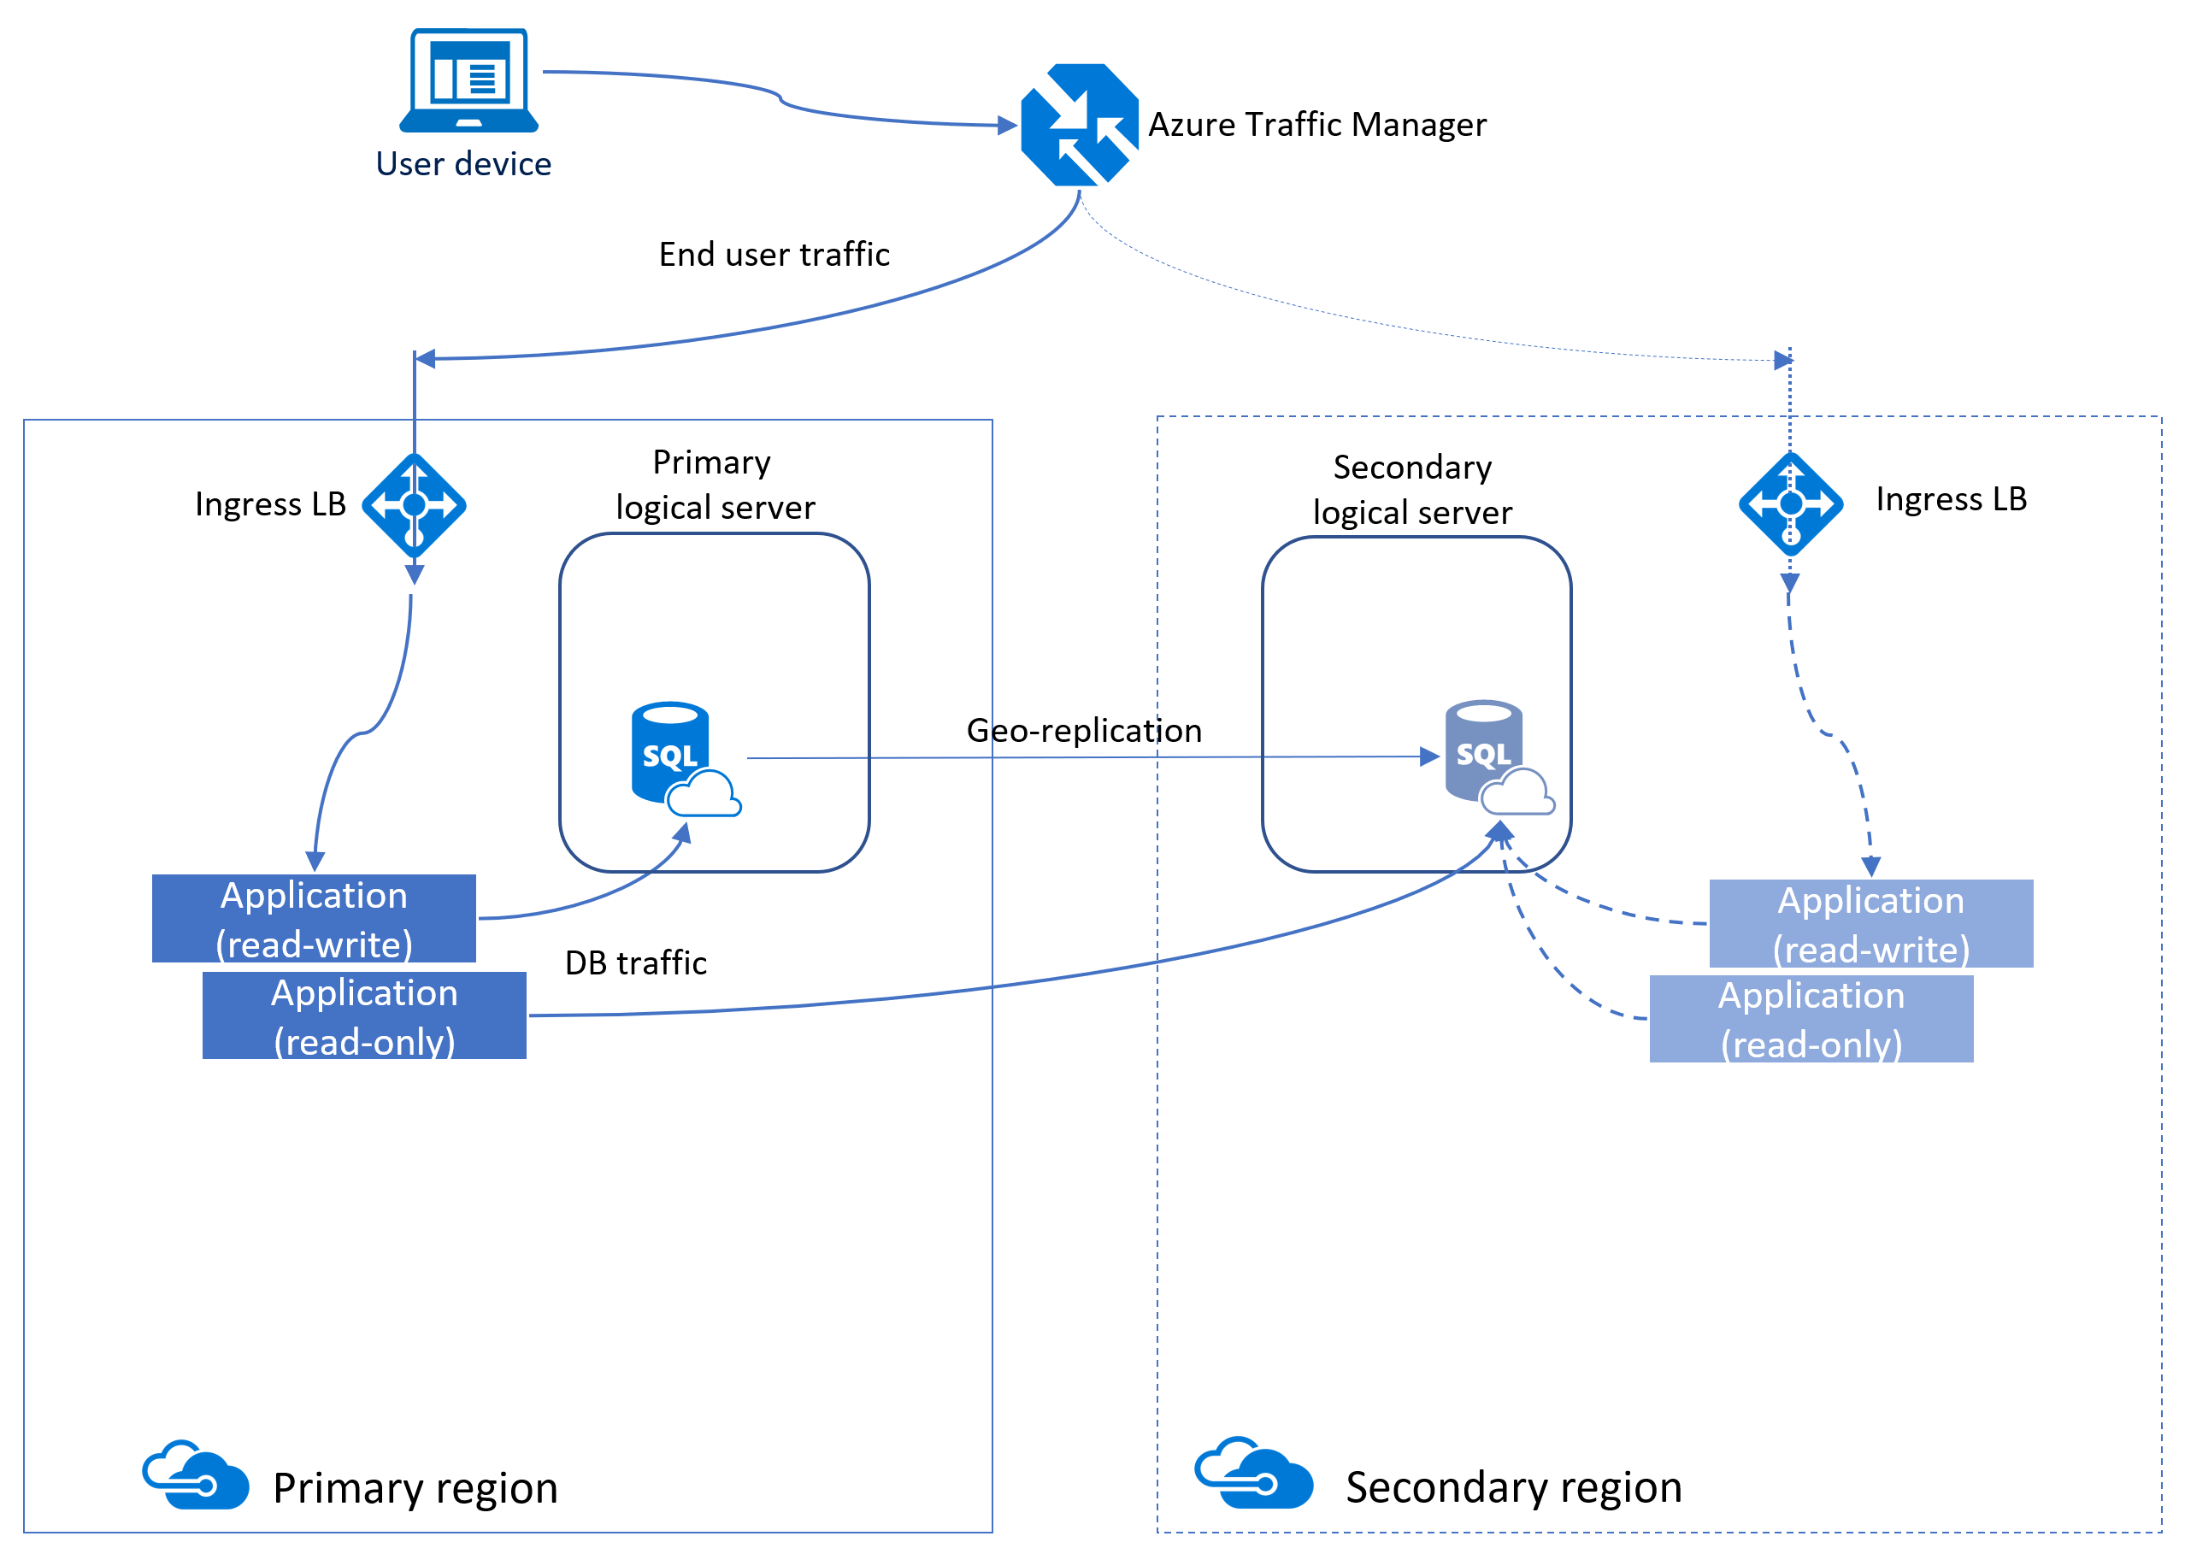
Azure SQL Database

Slide 51
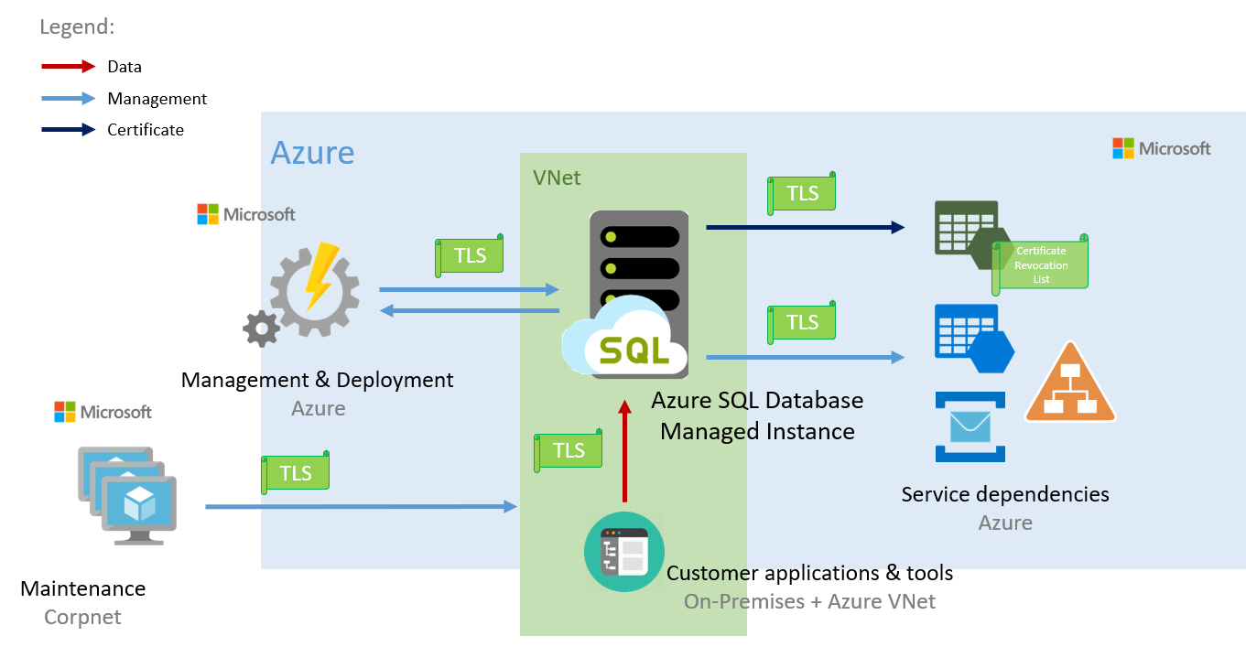
Azure SQL DB Managed Instance

Slide 52
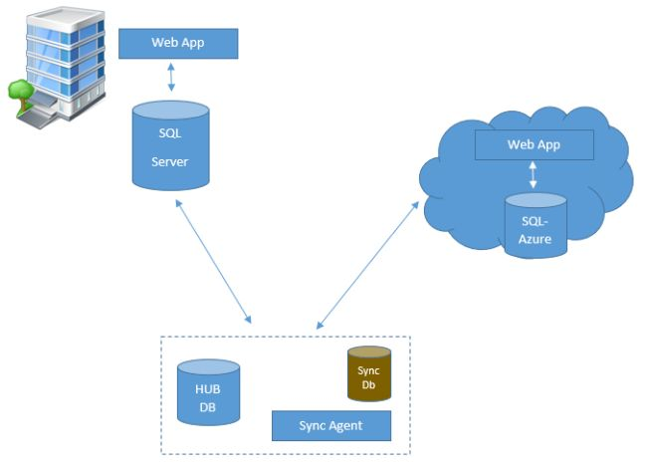
SQL Data Sync for Azure

Slide 53
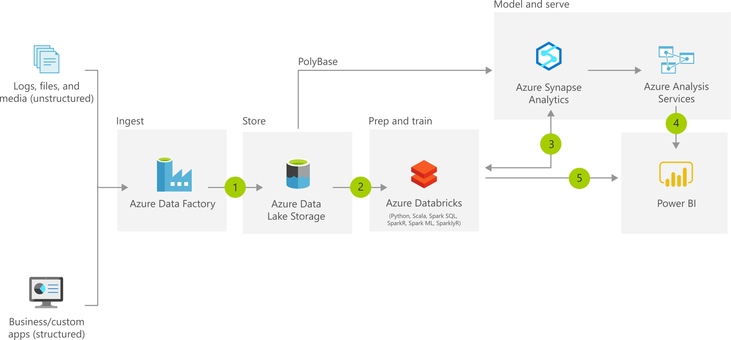
Azure Synapse

Slide 54
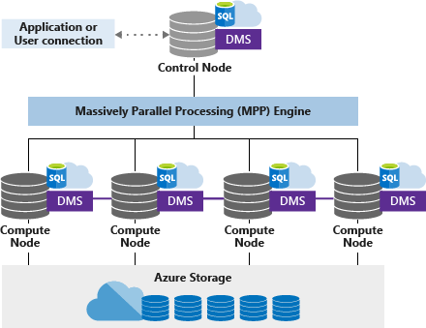
Azure Synapse SQL Pool (DW) Architecture

Slide 55
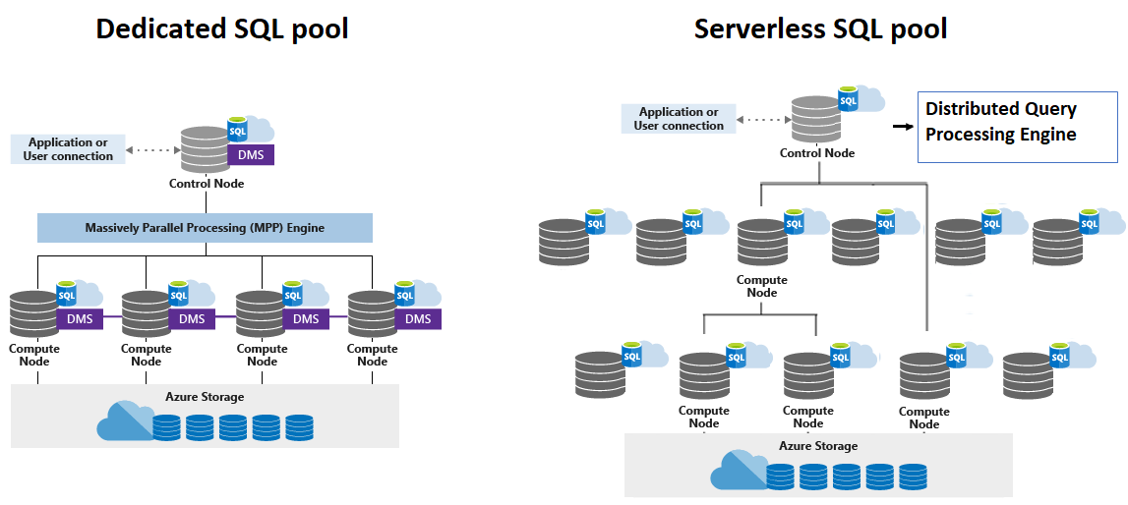
SQL Pool/Azure SQL Data Warehouse

Slide 56
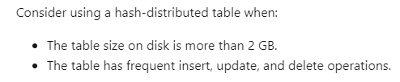
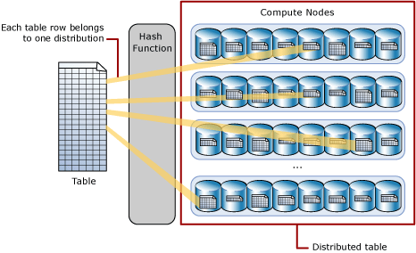
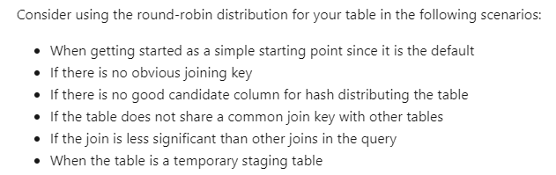
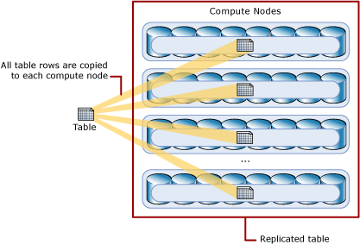
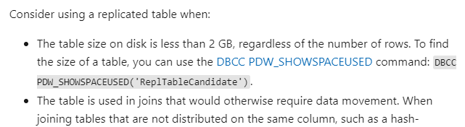
Azure Synapse Table Distribution Modes
https://timw.info/0jl

Slide 57
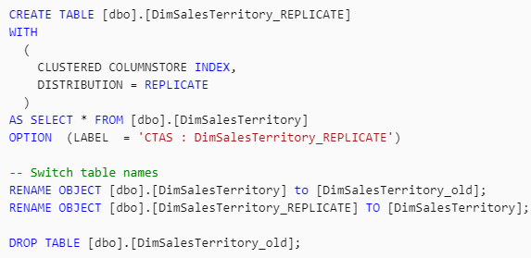
Azure Synapse Table Distribution Modes
https://timw.info/0jl

Slide 58
Exam DP-201 Item Types

Slide 59

Multiple Choice

Slide 60
Repeated Scenario
You need to move an Azure VM to another hardware host.
Solution: You redeploy the VM.
Does this solution meet the goal?
Yes
No

Slide 61

Select and Place

Slide 62

Build List and Reorder

Slide 63
Active Screen/Fill in the Blank

Slide 64
Case Study

Slide 65






Performance-Based Lab

Slide 66
Microsoft Online Testing

Slide 67
Microsoft Online Testing Process
timw.info/online

Slide 68
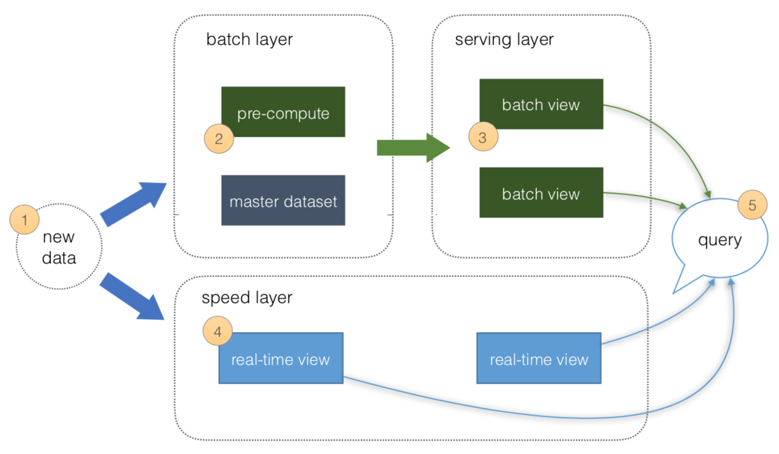
Lambda architectures from a real time mode perspective
Speed Layer:
The Speed layer processes data streams in real or near real time. This works well when the aim is to minimize the latency of the data ingestion to analysis:
New data ingested from sources
4. Real time views of the data created
Serving Layer:
The serving layer is optional in the real-time architecture and acts as the storage output of either the Batch or Speed layer that is used by client applications to access the results of the data-sets

Slide 69
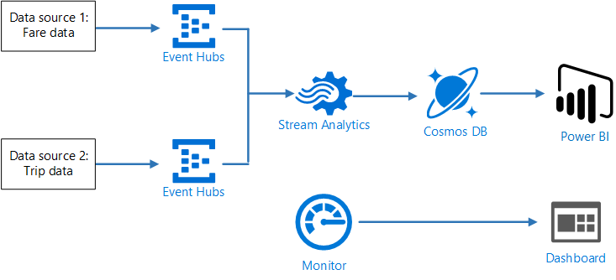
Architect a stream processing pipeline with Azure Stream Analytics

Slide 70
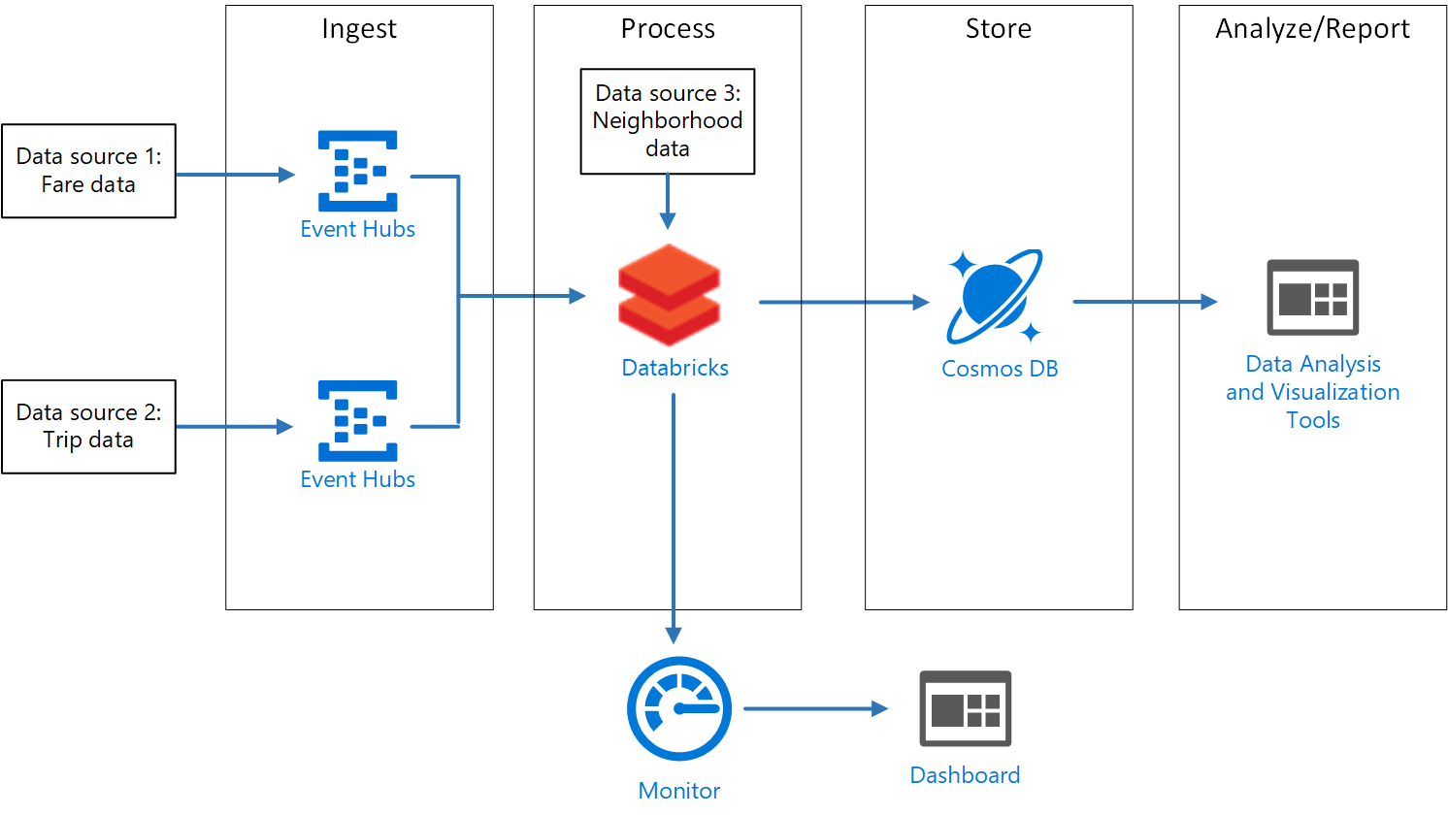
Design a stream processing pipeline with Azure Databricks

Slide 71
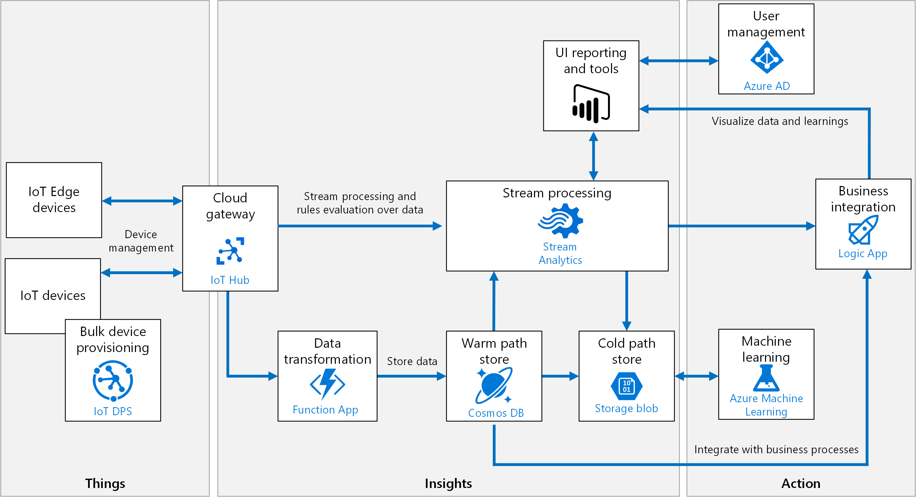
Create an Azure IoT reference architecture

Slide 72
Lambda architectures from a batch mode perspective
Batch Layer:
The Batch layer is used to pre-compute results on large volumes of data using a distributed data system:
New data ingested from sources
Data is precomputed
Serving Layer:
The serving layer acts as the storage output of either the Batch or Speed layer that is used by client applications to access the results of the data-sets:
Batch views can be used as precomputed views

Slide 73
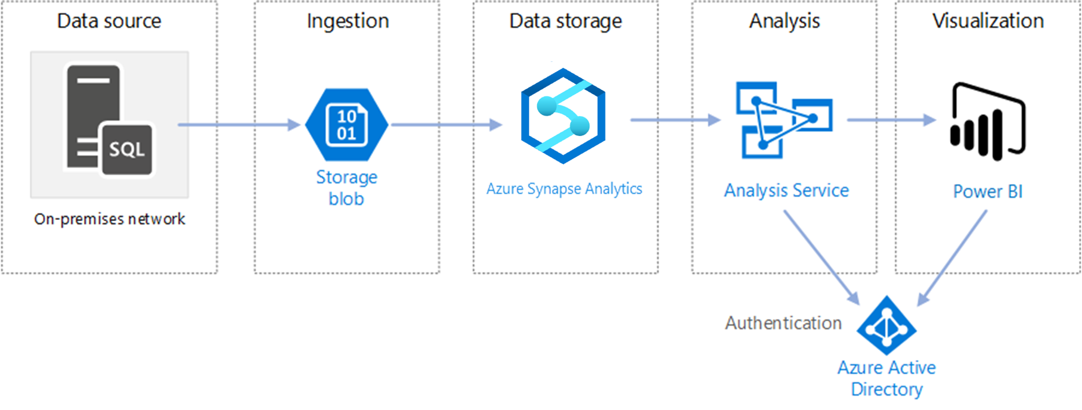
Design an enterprise business intelligence architecture

Slide 74
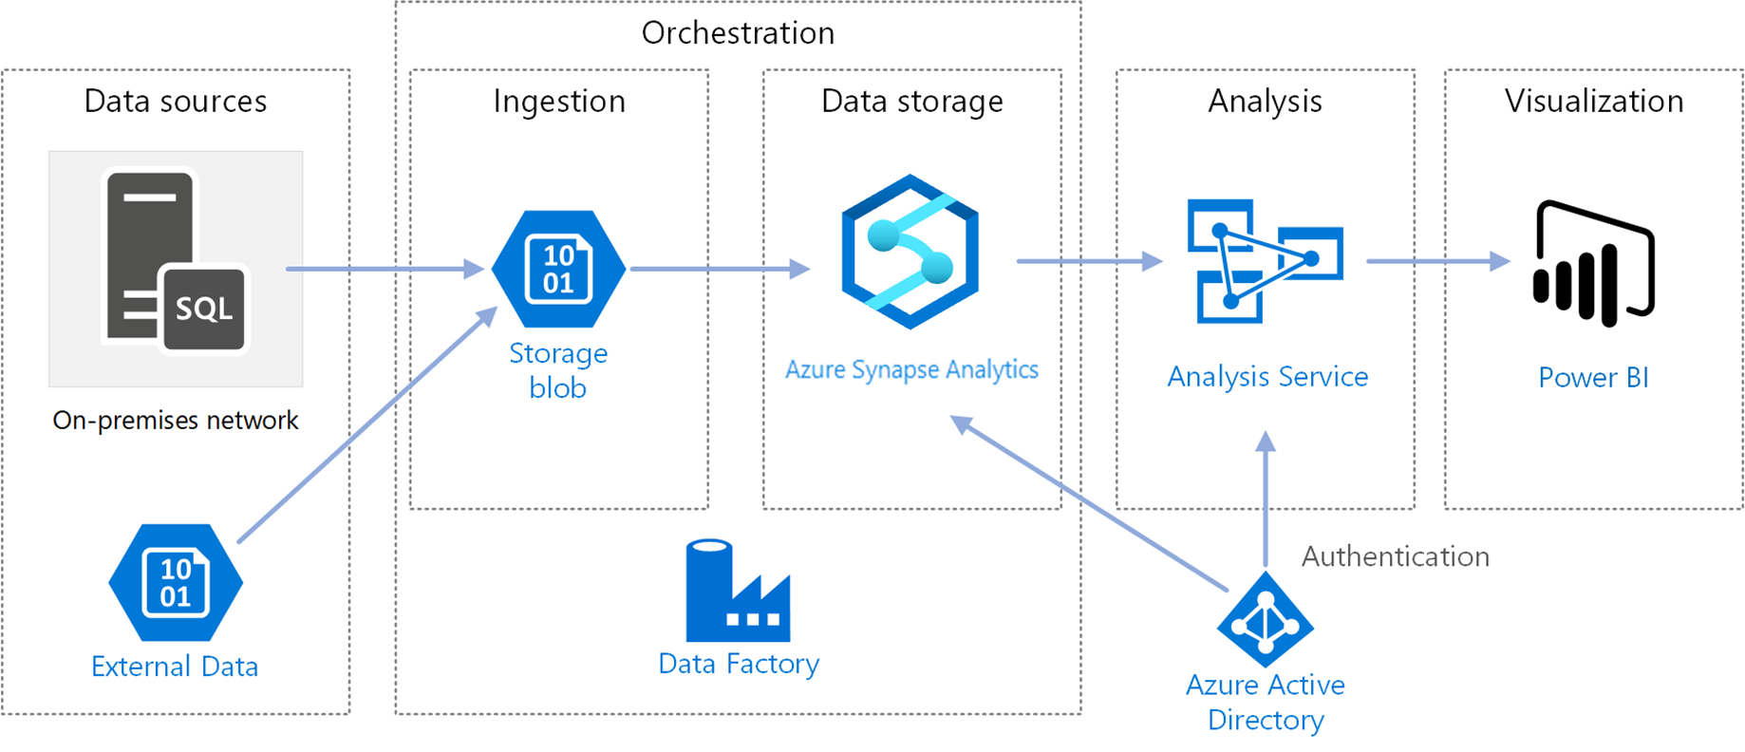
Automate an enterprise business intelligence architecture

Slide 75
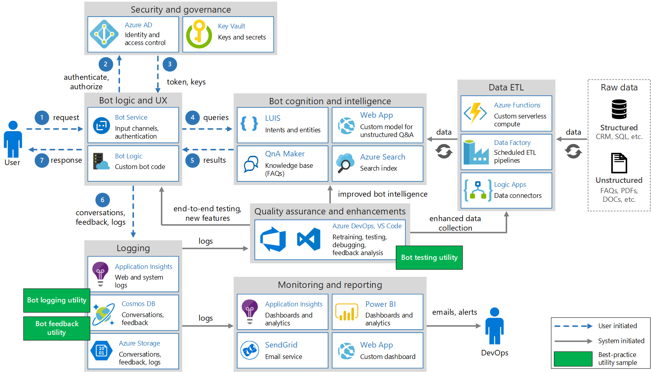
Architect an enterprise conversational bot

Slide 76
Design for security
Physical security
Identify & access
Perimeter
Network
Compute
Application
Data

Slide 77
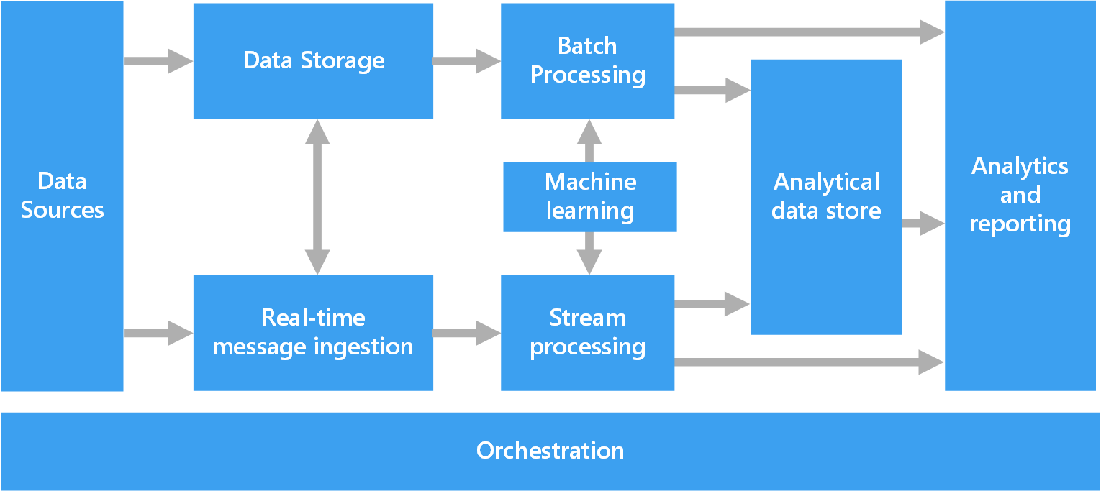
Big Data Architecture

Slide 78
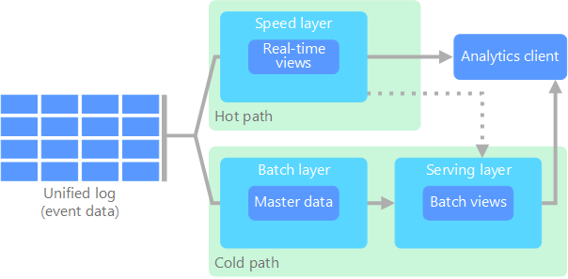
Lambda Architecture

Slide 79
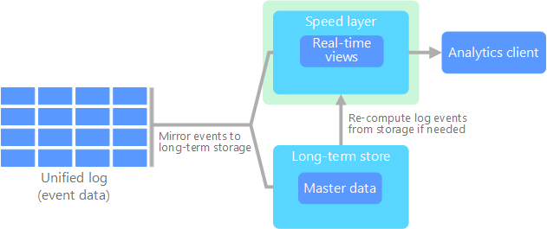
Kappa Architecture

Slide 80
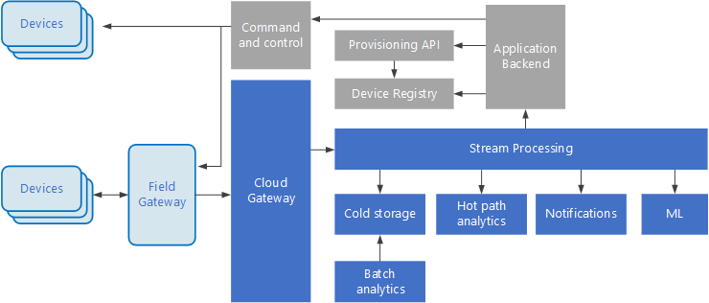
Internet of Things (IoT)

Slide 81
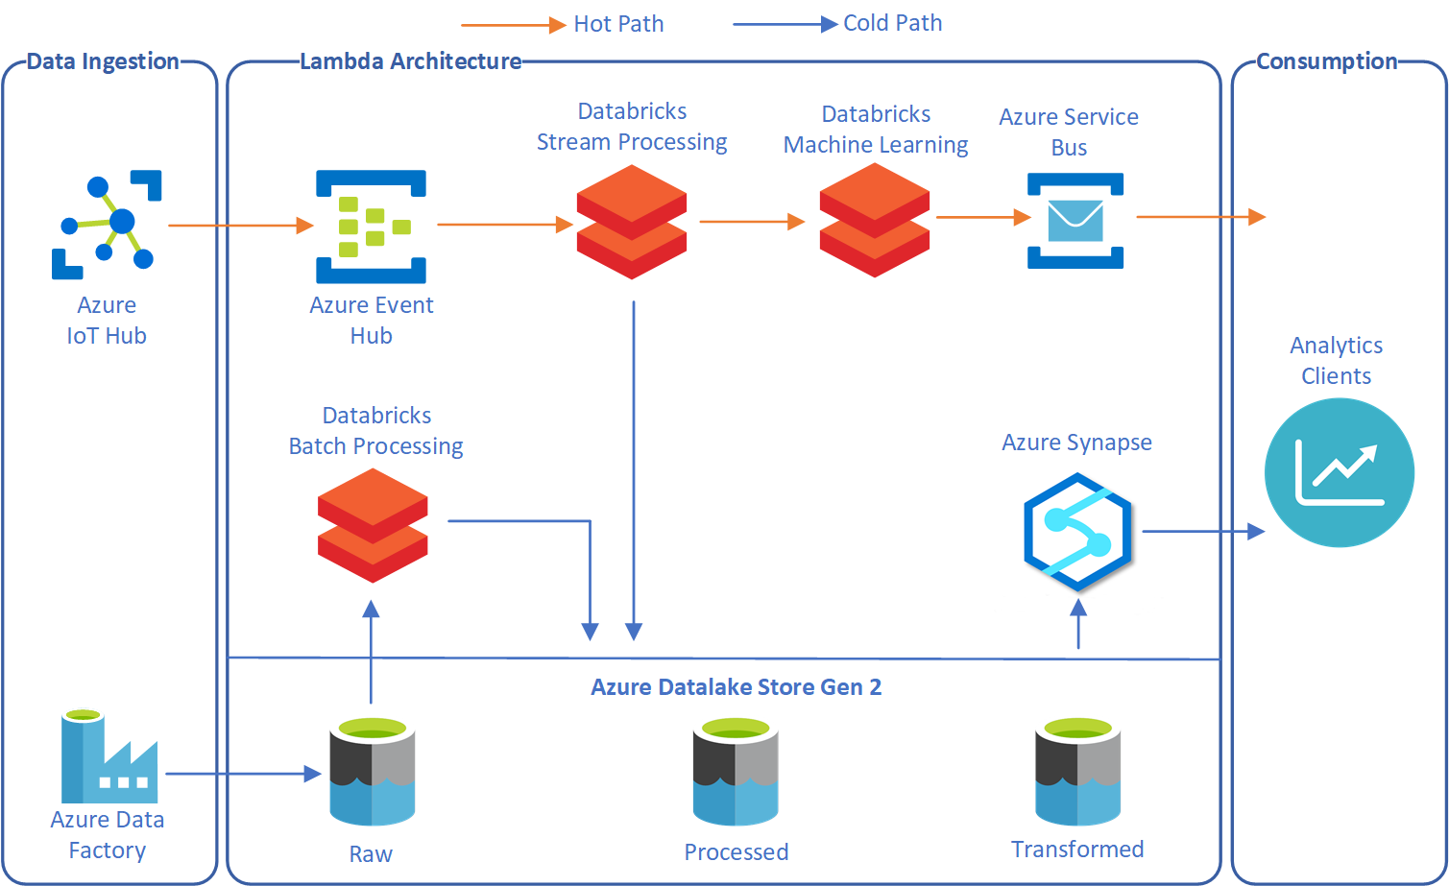
Lambda Architecture with Databricks

Slide 82
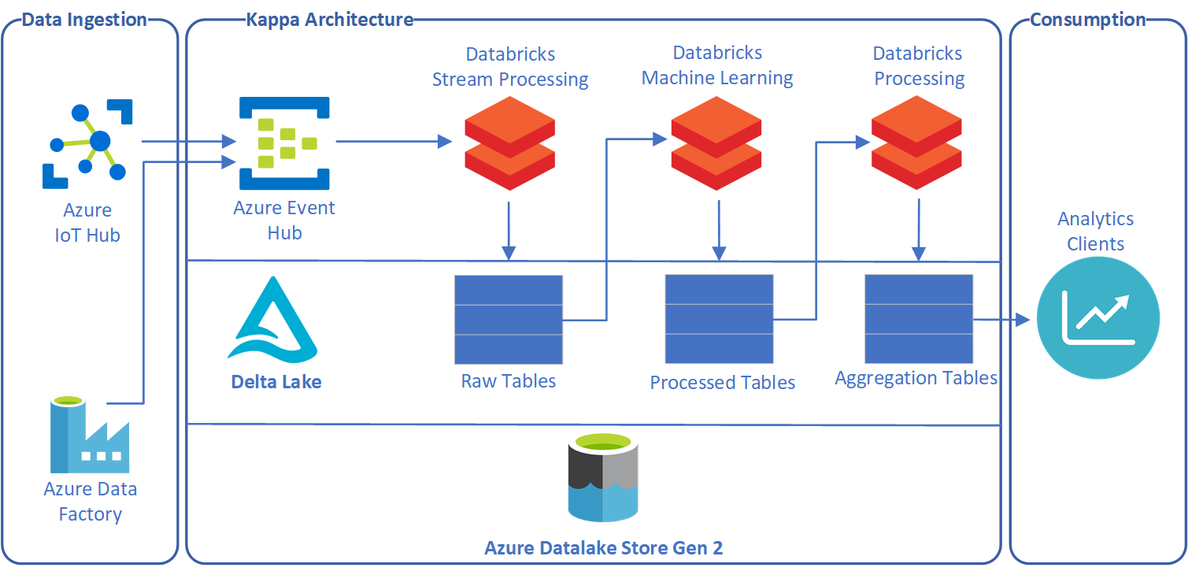
Kappa Architecture with Databricks

Slide 83
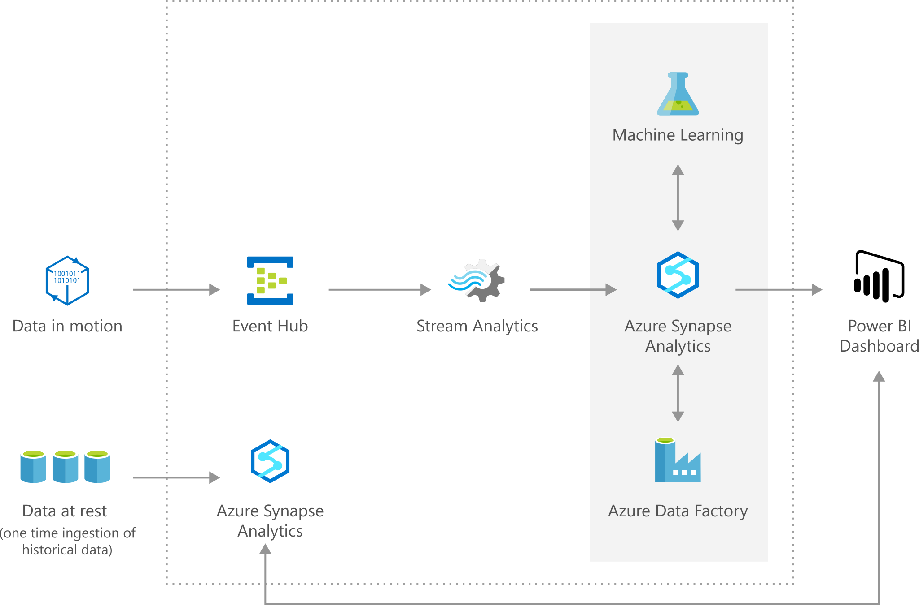
Oil and Gas Forecasting

